Slide 1
DOM Manipulation and Event Handling

Slide 2
Understanding the Document Object Model (DOM)
The DOM is a programming interface for web documents. It represents the structure of a document as a tree of objects, allowing JavaScript to interact with HTML and XML documents.
The document is structured as a hierarchy of nodes, where each node represents an element, attribute, or piece of text.
Through the DOM, JavaScript can manipulate the structure, style, and content of a webpage, enabling dynamic updates.
https://www.w3schools.com/js/js_htmldom.asp

Slide 3
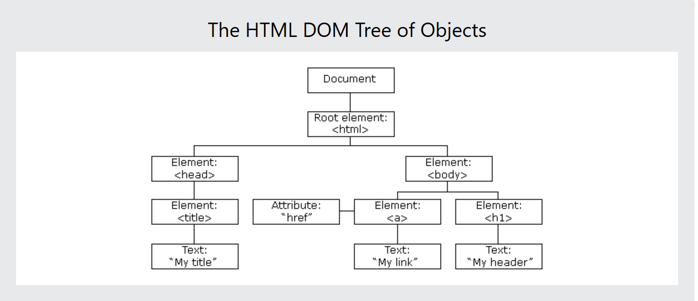
document Object
Root of the DOM
Represents the entire web page
JavaScript can change all the HTML elements in the page
01
JavaScript can change all the HTML attributes in the page
02
JavaScript can change all the CSS styles in the page
03
JavaScript can remove existing HTML elements and attributes
04
JavaScript can add new HTML elements and attributes
05
JavaScript can react to all existing HTML events in the page
06
JavaScript can create new HTML events in the page
07
With the object model, JavaScript gets all the power it needs to create dynamic HTML:

Slide 4
Where is DOM Manipulation Used in JavaScript?
Updating content dynamically (e.g., changing text or images on user actions)
Showing or hiding elements (e.g., dropdowns, modals, accordions)
Form validation and real-time feedback (e.g., error messages, input highlighting)
Adding, removing, or modifying HTML elements (e.g., adding list items, comments)
Changing CSS styles dynamically (e.g., theme toggles, animations)
Creating interactive UI components (e.g., tabs, sliders, carousels)
Handling events and user interactions (e.g., clicks, mouse movements)

Slide 5
🔍 DOM SELECTORS
Selector Type | Method | Returns | Example
By ID | getElementById() | Single Element | document.getElementById("title")
By Class | getElementsByClassName() | HTMLCollection | document.getElementsByClassName("item")
By Tag | getElementsByTagName() | HTMLCollection | document.getElementsByTagName("div")
CSS (Single) | querySelector() | First Match | document.querySelector(".box")
CSS (All) | querySelectorAll() | NodeList | document.querySelectorAll(".box")

Slide 6
Direction | Property | Returns | Notes
Down (children) | .children | HTMLCollection of child elements | Elements only, no text nodes
 | .childNodes | NodeList of all child nodes | Includes text, comments etc.
Up (parent) | .parentNode | Parent node | Usually an element
 | .parentElement | Parent element (or null if none) | Only elements
Sideways (siblings) | .nextSibling | Next sibling node | Includes text nodes
 | .nextElementSibling | Next sibling element | Elements only
 | .previousSibling | Previous sibling node | Includes text nodes
 | .previousElementSibling | Previous sibling element | Elements only
DOM Traversing
It means navigating through nodes in the DOM tree, like:
Going down to children
Going up to parents
Going sideways to siblings

Slide 7
🛠️ DOM MANIPULATIONS
🔤 Content
Task | Code Example
Set text | el.textContent = "Hello"
Set HTML | el.innerHTML = "<strong>Hello</strong>"
Get text | let txt = el.textContent
Get HTML | let html = el.innerHTML
🎨 Styling
Task | Code Example
Set style | el.style.color = "red"
Add class | el.classList.add("highlight")
Remove class | el.classList.remove("active")
Toggle class | el.classList.toggle("active")

Slide 8
⚙️ Attributes
Task | Code Example
Get attribute | el.getAttribute("href")
Set attribute | el.setAttribute("src", "image.jpg")
Remove attribute | el.removeAttribute("disabled")
🧱 Creating & Modifying Elements
Task | Code Example
Create element | document.createElement("div")
Set content | el.textContent = "New item"
Append to parent | parent.appendChild(el)
Insert at start | parent.prepend(el)
Remove element | el.remove()

Slide 9
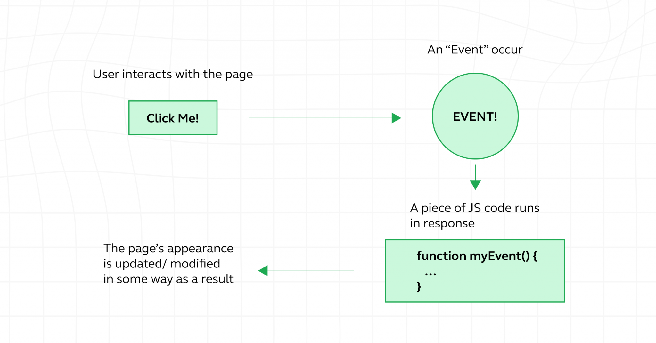
Event Handling
An event = something that happens in the browser. Examples:
User clicks a button
Mouse moves
A key is pressed
Event handling in JavaScript is how you make your web page respond to user interactions — like clicks, typing, scrolling, submitting forms, etc.
You “handle” events by writing functions that run when a certain event happens.
https://www.w3schools.com/js/js_htmldom_events.asp

Slide 10
Different Types of Events in JavaScript
⌨️ Keyboard Events: Triggered by keyboard input.
Event | Description
keydown | Key is pressed down
keyup | Key is released
keypress | (Deprecated), key is pressed
🖱️ Mouse Events: Triggered by mouse actions.
Event | Description
click | When mouse is clicked
dblclick | When mouse is double-clicked
mousedown | Mouse button is pressed down
mouseup | Mouse button is released
mouseover | Mouse enters the element
mouseout | Mouse leaves the element
mousemove | Mouse is moved
contextmenu | Right-click on an element
📝 Form Events: Used to handle input & form interactions.
Event | Description
submit | Form is submitted
input | Input value changes while typing
change | Input value changes after blur
focus | Element gains focus
blur | Element loses focus
reset | Form is reset

Slide 11
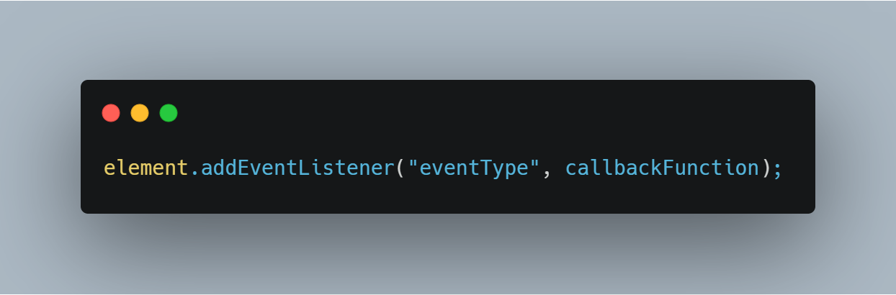

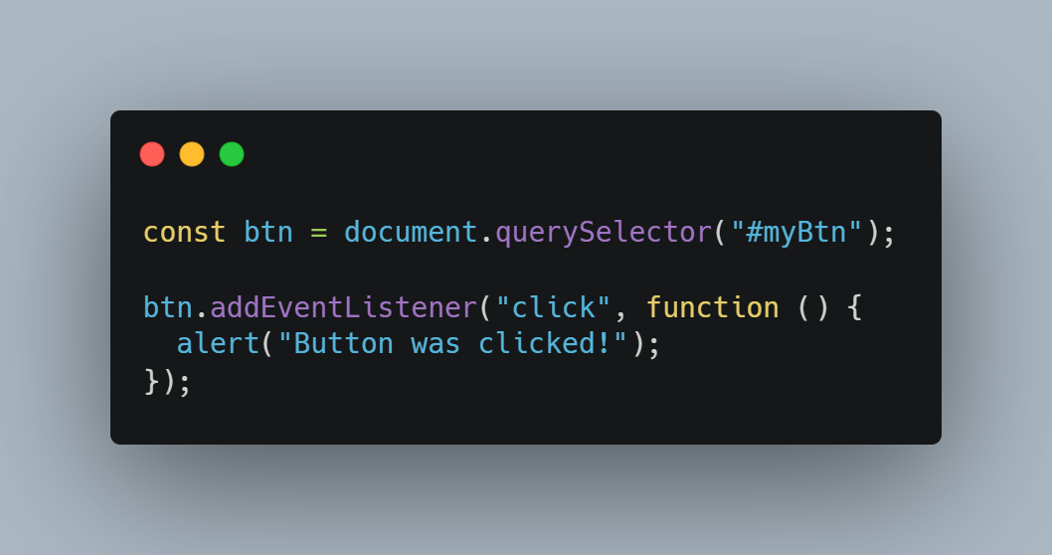
Event Listener
An event listener is a function that listens for a specific event on an element and runs a callback function when the event occurs.
Syntax
Example

Slide 12
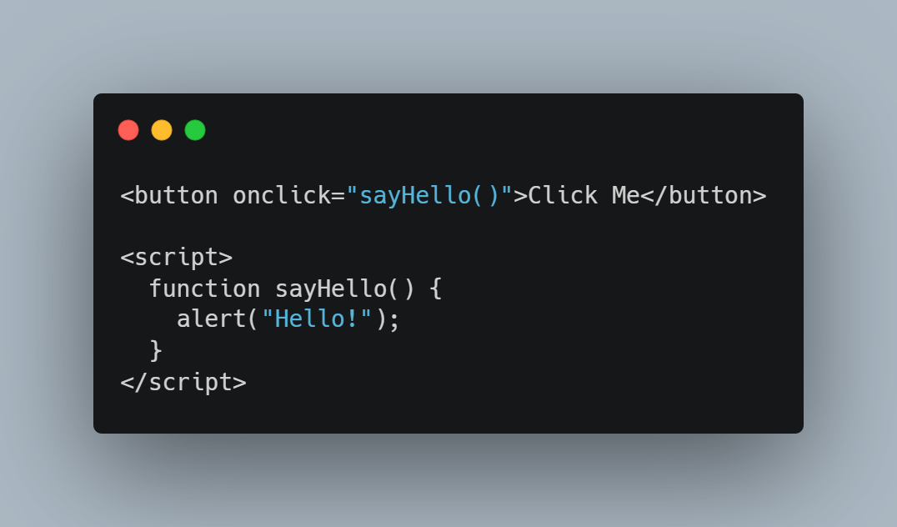
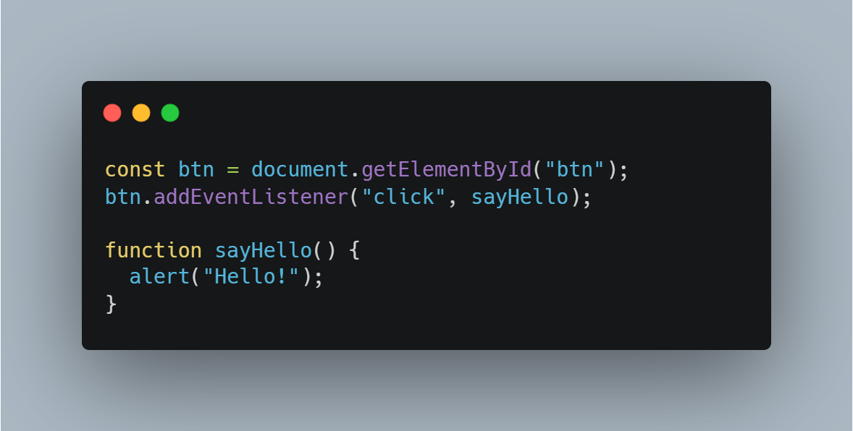
What is an Event Handler?
An event handler is the actual function that runs when the event occurs.
There are two main ways to define it :
Inline Handler (HTML way — not recommended)
DOM Handler (Recommended)

Slide 13
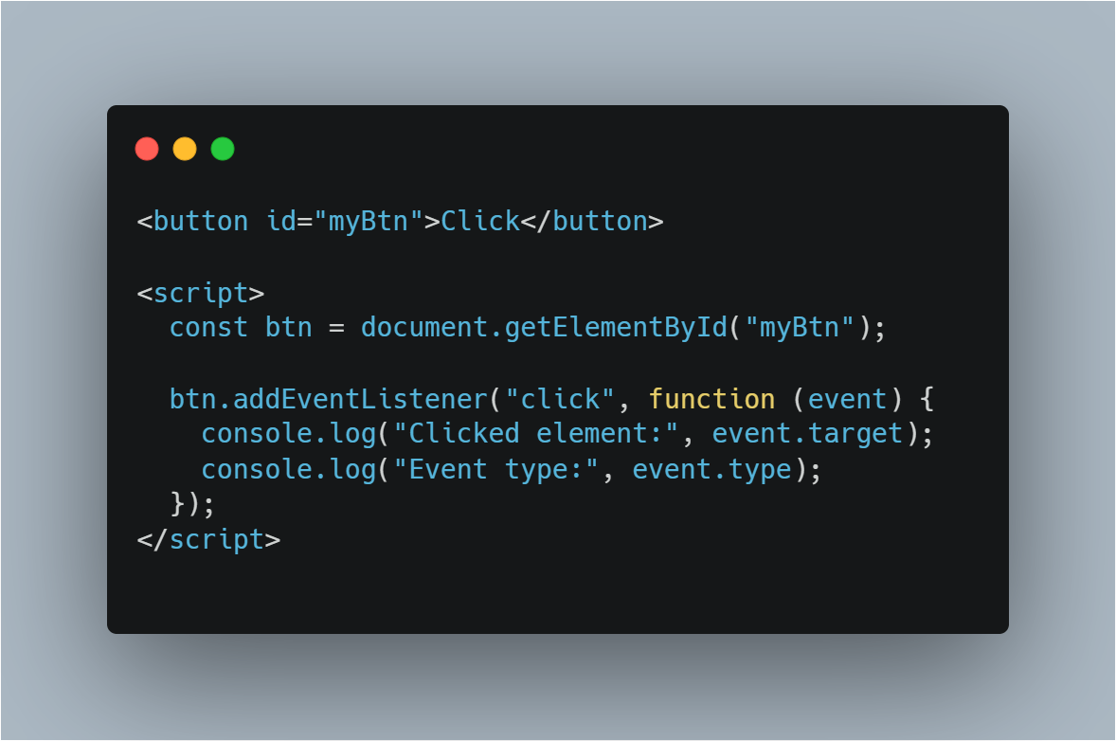
Event Object
When an event occurs, JavaScript automatically passes an event object to the handler function. This object contains details about the event — like:
Property | Description
event.type | Type of event (click, submit, etc.)
event.target | The actual element that triggered the event
event.preventDefault() | Prevents default browser behavior (like form submission)
event.clientX, event.clientY | Mouse coordinates
event.key | Key pressed (for keyboard events)
Example

Slide 14
🔄 Event Flow in JavaScript
When an event (like a click) occurs on a DOM element, it doesn’t just stop there — it travels through the DOM in three phases:
📊 The 3 Phases of Event Flow:
Capturing Phase (a.k.a. Capture or Trickling Down) → The event starts at the top (<html>) and moves down toward the target element.
Target Phase → The event reaches the actual element that was clicked or interacted with.
Bubbling Phase → After reaching the target, the event bubbles back up the DOM tree to the root.
https://javascript.plainenglish.io/event-flow-in-javascript-7327fb9f178b

Slide 15
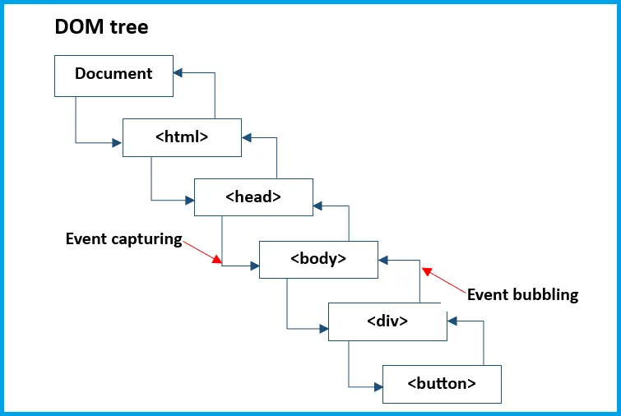
🔁 1. Event Bubbling (Default)
Most common phase
Events go from the target element upward to its ancestors.
Event listeners attached during bubbling will catch the event on the way up.
🔄 2. Event Capturing (Less Common)
Opposite of bubbling
Events go from the root down to the target.
You can listen during this phase by passing { capture: true } as a third argument.
⚠️ 3. Stopping Propagation
Sometimes you don’t want the event to bubble up or continue through capture.
Method | What it does
event.stopPropagation() | Stops the event from bubbling or capturing further

Slide 16
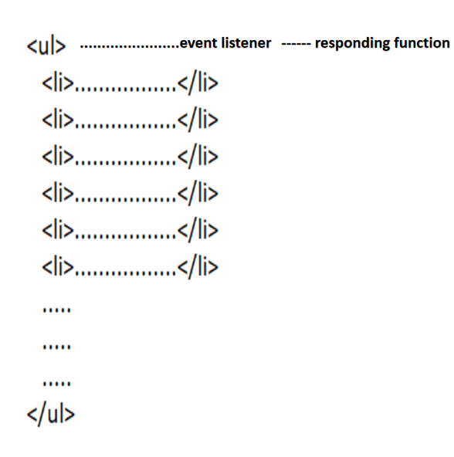
What is Event Delegation?
Event Delegation is a technique where you attach a single event listener to a parent element and then use the event object to detect which child element triggered the event. Instead of adding listeners to each individual child, you delegate the event handling to the parent.
Why Use Event Delegation?
Benefit | Explanation
✅ Better performance | Especially useful when handling many elements
✅ Easier DOM updates | Works even for dynamically added child elements
✅ Cleaner code | Fewer event listeners = simpler, less repetitive code
https://www.geeksforgeeks.org/javascript/event-delegation-in-javascript/

Slide 17
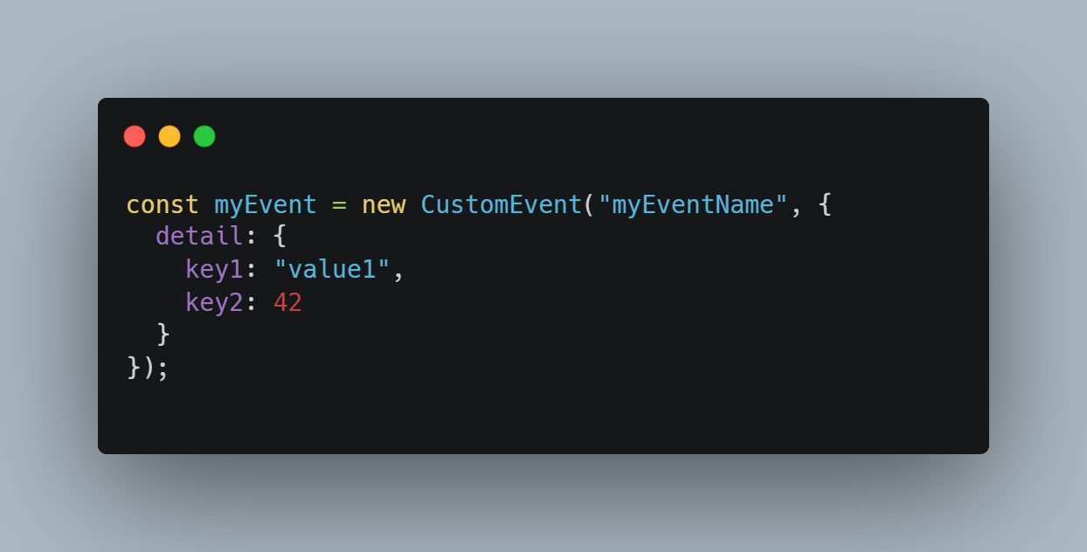
🔧 Custom Events
Custom Events allow you to define and dispatch your own events, not just built-in ones like click, keydown, etc.
"myEventName" → your custom event name (can be anything)
detail → optional object to pass data with the event

Slide 18
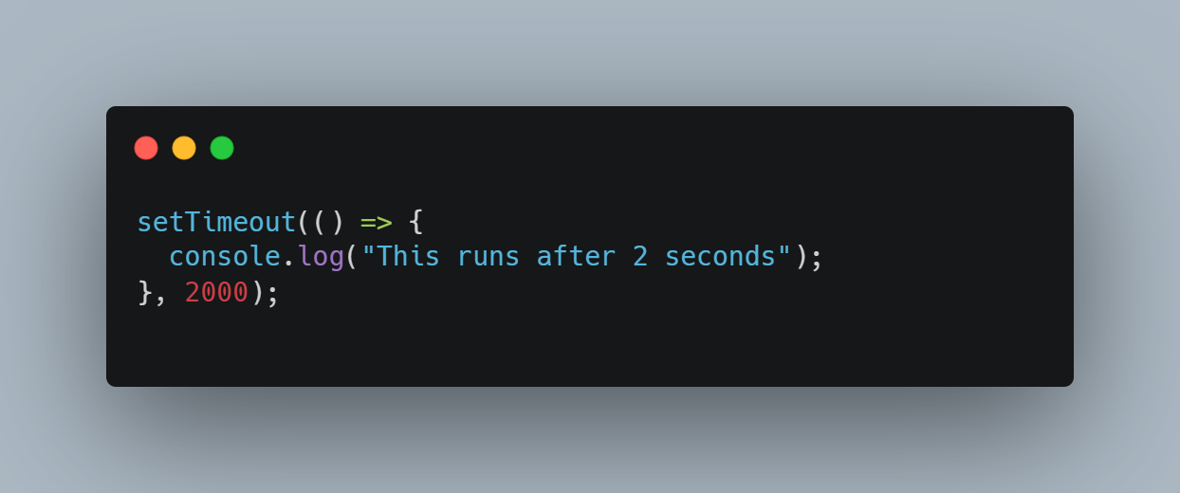
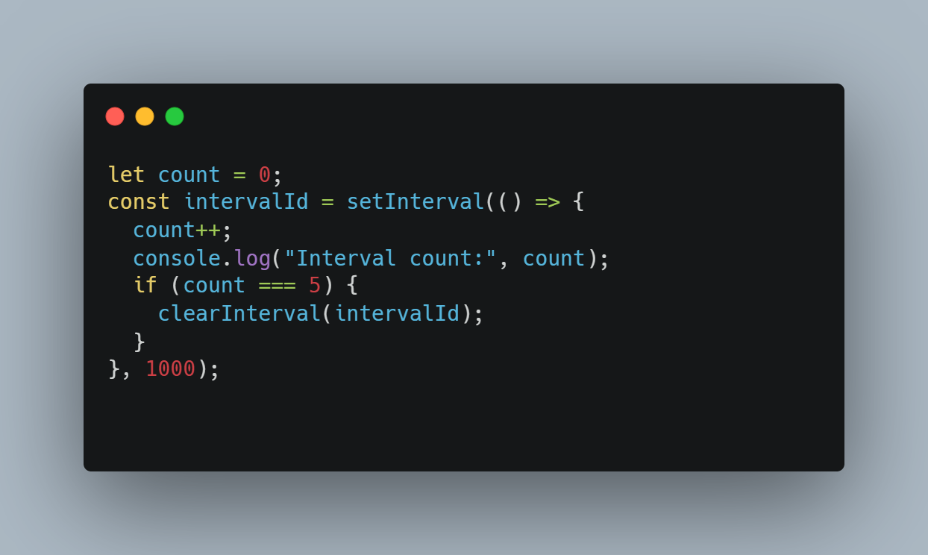
⏱️Timers (setTimeout, setInterval)
Used to run code after a delay or repeatedly over time.
Method | Description
setTimeout() | Runs code once after a delay
setInterval() | Runs code repeatedly at interval
clearTimeout() | Cancels a timeout
clearInterval() | Cancels an interval
Example: setTimeout
Example: setInterval

Slide 19
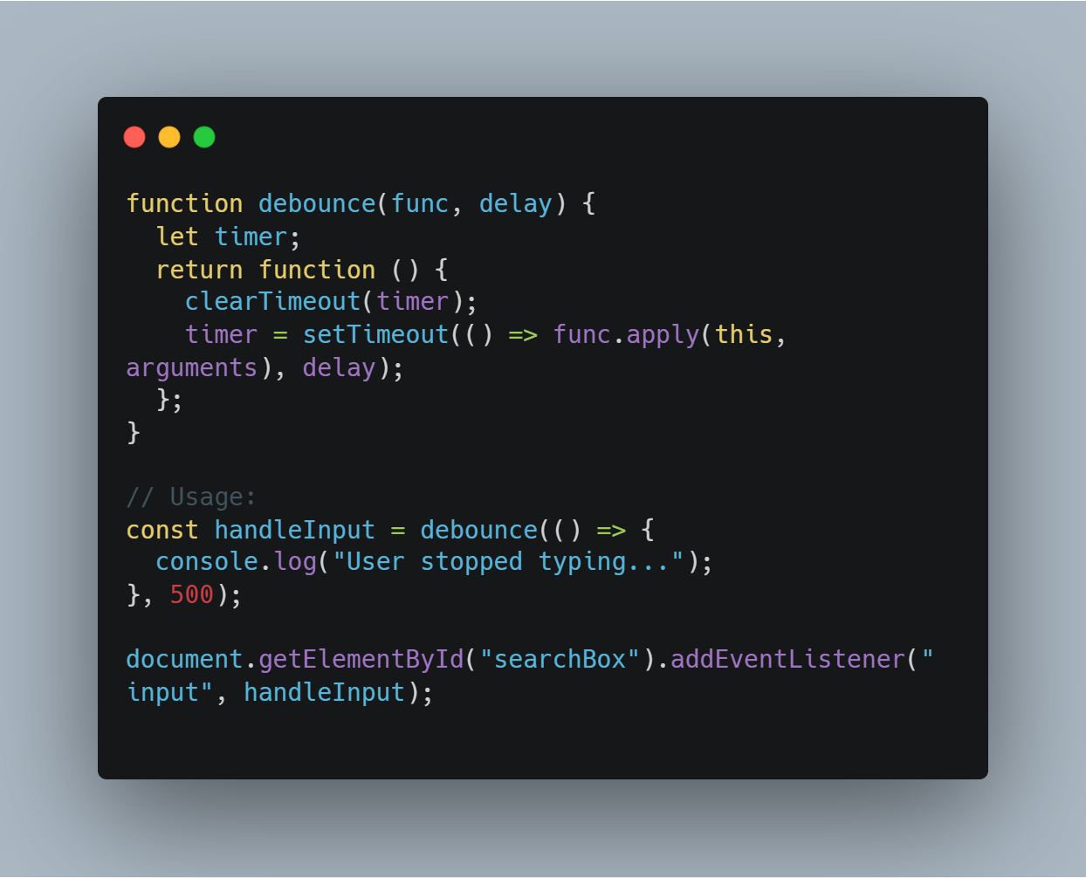
Debouncing
Debouncing ensures a function is only called after a delay — useful when someone is typing or resizing and you don't want to trigger an event constantly.
Debounce Example

Slide 20

Thank you!
Chandu B R
Junior Developer
chandu.busanahalliravindra@endava.com
Feel free to reach out with any questions or thoughts!

